Slide 1




Time Series Analysis of Hong Kong Transportation Stocks
Explore the time series analysis of three Hong Kong transportation stocks:
冠忠 (0306.HK)
MTR (0066.HK)
载通 (0062.HK).
Dive into data, modeling, and forecasting for insights into their performance.

Slide 2



CONTENTS
01. Introduction and Background
02. Data Collection and Preprocessing
03. Time Series Modeling and Forecasting
04. Modeling Techniques and Results
05. Forecasting and Future Outlook
06. Conclusion and Discussion

Slide 3


Introduction and Background
01
·Overview of the importance of transportation stocks as economic indicators and their significance in Hong Kong's economy.
·Introduction to the three key transportation stocks: 冠忠 (0306.HK), MTR (0066.HK), and 载通 (0062.HK).

Slide 4


Transportation Stocks: Economic Significance & Investment Opportunities
Economic Indicator
Industry Significance
Investment Opportunities
As a global financial hub, Hong Kong's transportation sector facilitates international trade, enhancing economic competitiveness.
With increasing demand for efficient services, investing in transportation stocks offers potential returns and portfolio diversification.
Hong Kong's transportation stocks reflect the city's economic health, crucial for trade and business activities.

Slide 5



Introducing the Stocks: 冠忠, MTR, and 载通
冠忠
(0306.HK)
MTR
(0066.HK)
载通
(0062.HK)
Leading bus and minibus operator offering public transportation services in Hong Kong.
World-class rapid transit railway system, serving as Hong Kong's urban mobility backbone.
Diversified transportation conglomerate, engaged in logistics, freight, and passenger services.

Slide 6
Data Collection and Preprocessing
02
·Explanation of data collection sources (Yahoo Finance) and preprocessing steps
.
·Importance of handling missing values, outliers, and converting stock prices into log-returns for analysis.

Slide 7

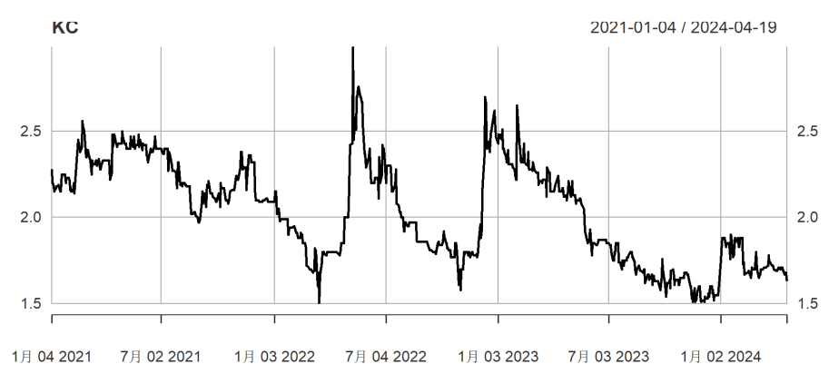
Data Collection and Preprocessing
Data Sources
·Historical stock prices obtained from Yahoo Finance

Slide 8
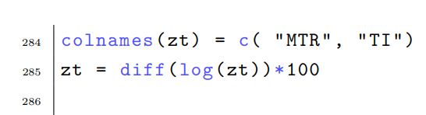
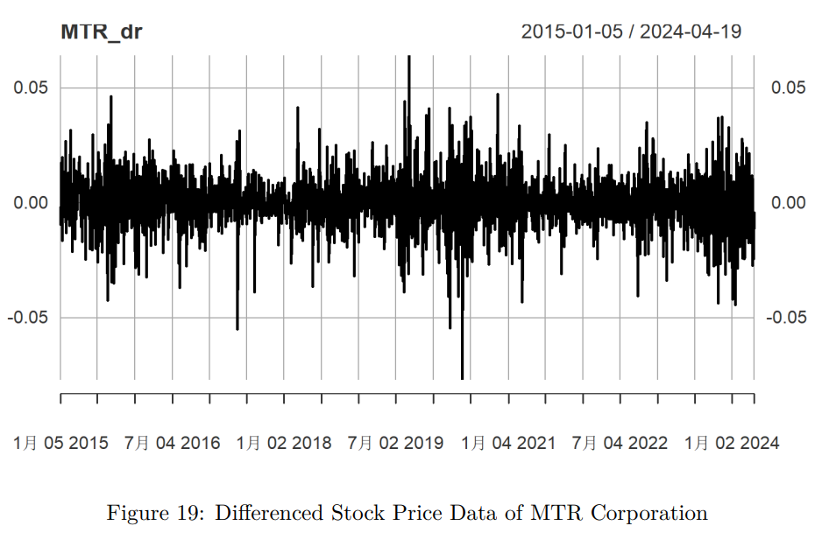
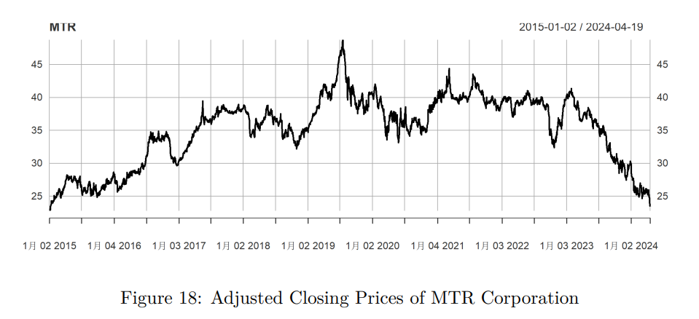
Data Collection and Preprocessing
Data Preprocessing
·Handle missing values, outliers, and ensure data integrity.
·Convert stock prices into log-returns to make them stationary and enhance their statistical properties.

Slide 9
Time Series Modeling and Forecasting
03
·Univariate Analysis: Analyzing individual stock trends, identifying patterns, and forecasting future movements.
·Multivariate Analysis: Incorporating macroeconomic and industry factors for enhanced predictions.
·Model Evaluation: Assessing forecast accuracy and reliability using appropriate metrics.

Slide 10
Time Series Modeling and Forecasting
Univariate Analysis
Multivariate Analysis
Model Evaluation
Analyze stock price and volume data using univariate time series models.
Enhance predictive power by incorporating macroeconomic and industry-specific factors into the models.
Assess forecast accuracy and reliability using suitable performance metrics.

Slide 11

Univariate Analysis
Delve into the distinctive characteristics of each stock (冠忠, MTR, and 载通) through univariate time series analysis. Analyze historical price trends, pinpoint key patterns, and forecast future movements for informed investment decisions. Explore the nuances of each stock's time series data.

Slide 12
Modeling Techniques and Results
04
·Stationary and White Noise Tests: Assessing stationarity and randomness of stock prices.
·Arch Effect Test: Understanding conditional heteroscedasticity.
·Order Selection of ARIMA: Determining optimal model orders using AIC.
·ARMA-EGARCH Fitting: Fitting models to capture volatility clustering and leverage effects.
·Model Checking: Verifying model assumptions and residual analysis.

Slide 13

Stationarity and White Noise Tests
In this section, we'll conduct stationary and white noise tests on the three transportation stocks: 冠忠, MTR, and 载通. These tests are critical for assessing whether stock prices meet the stationarity and randomness assumptions essential for time series analysis. Let's delve into the results:

Slide 14

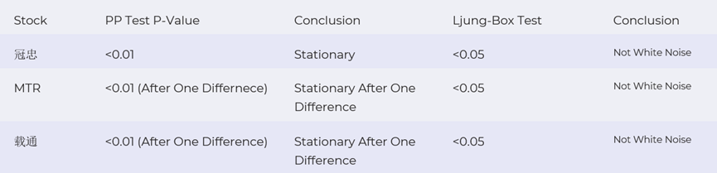
Stationarity and White Noise Tests
In this section, we'll conduct stationary and white noise tests on the three transportation stocks: 冠忠, MTR, and 载通. These tests are critical for assessing whether stock prices meet the stationarity and randomness assumptions essential for time series analysis. Let's delve into the results:

Slide 15
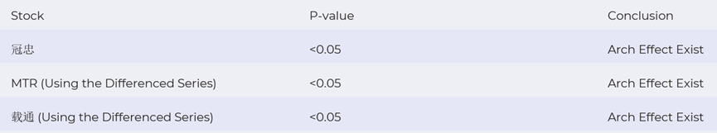
ARCH Effect Test
In this section, we'll perform an ARCH effect test on the three transportation stocks: 冠忠, MTR, and 载通. This test helps us determine the presence of conditional heteroscedasticity in stock returns. Let's examine the results:

Slide 16
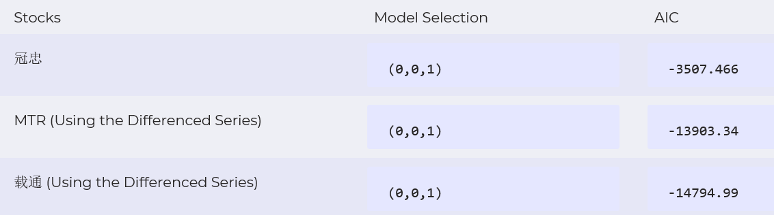
Order Selection of ARIMA
AIC (Akaike Information Criterion) standard is used to select the optimal model.

Slide 17
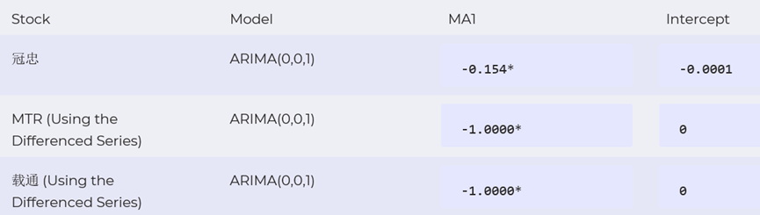
Model Estimation
After selecting the optimal model order, the next step is to estimate the model parameters. We will use the maximum likelihood estimation method to estimate the parameters of our ARIMA models. This will allow us to make accurate forecasts of the Hong Kong transportation stocks.
Note: "*" indicates significance at the 5% significance level.

Slide 18
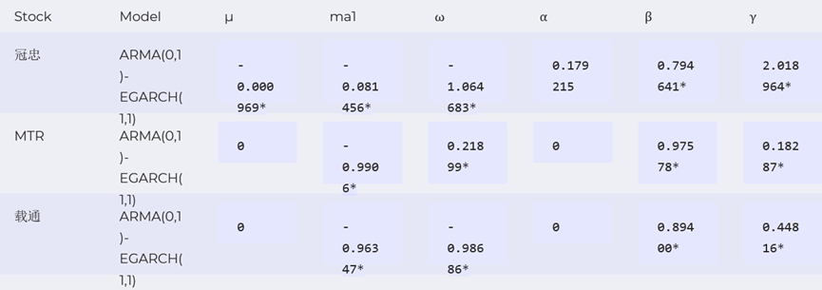
ARMA-EGARCH Fitting
Next, we fit an ARMA-EGARCH model to the Hong Kong transportation stocks data to capture the volatility clustering and leverage effects. The table below displays the results of the model estimation.
Note: "*" represents significance at the 5% level.

Slide 19
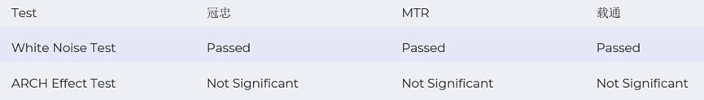
Model Checking
Before we finalize our time series model, we need to check its assumptions. In this step, we will check whether the residuals of the ARMA-EGARCH model satisfy the white noise assumption and have an ARCH effect.

Slide 20
Forecasting and Future Outlook
05
·Presenting forecasting results for each stock based on the time series models.
·Discussing potential future trends and investment opportunities in the transportation sector.

Slide 21
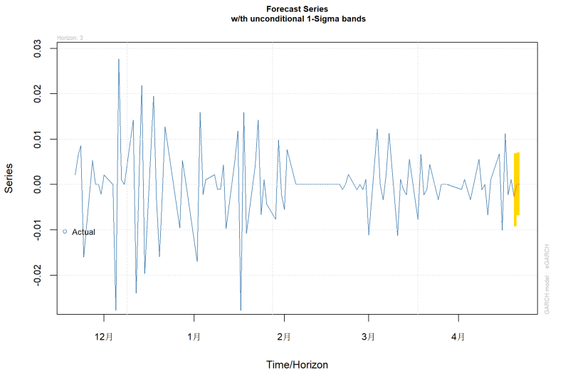
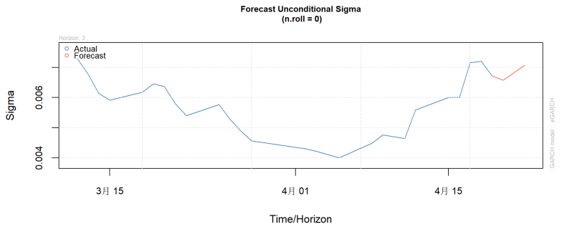
Forecasting Results for 冠忠
Based on our time series model, we have generated a forecast for 冠忠 that predicts volatility.

Slide 22
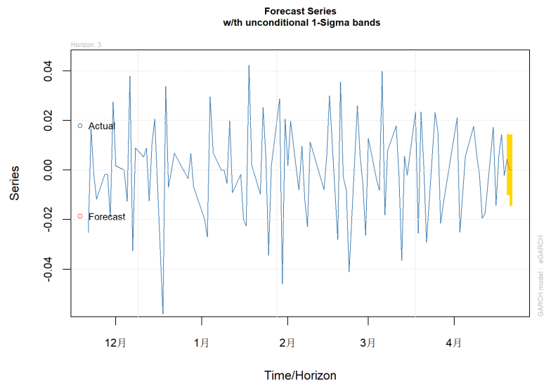
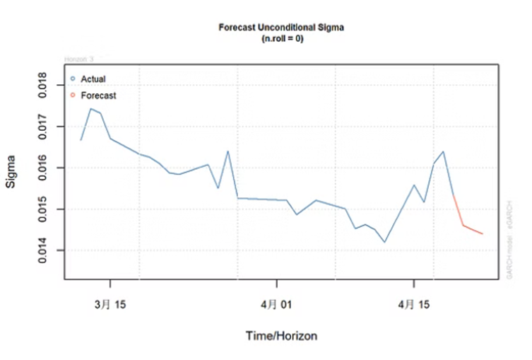
Forecasting Results for MTR
Our time series model predicts a decline in the stock price of MTR over the next quarter, with a possible decrease in demand due to increased competition.

Slide 23
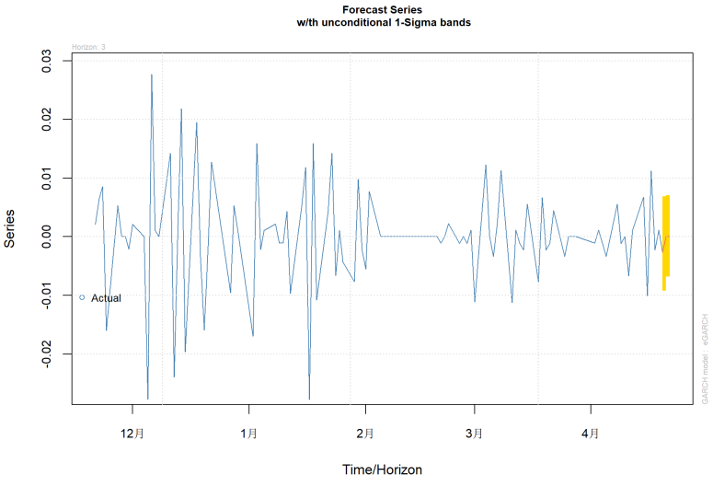

Forecasting Results for 载通
As for 载通, our model predicts a modest increase in stock price driven by increased demand for transportation services. Investors should approach MTR with caution, while considering investing in 载通 as a potential growth opportunity.

Slide 24
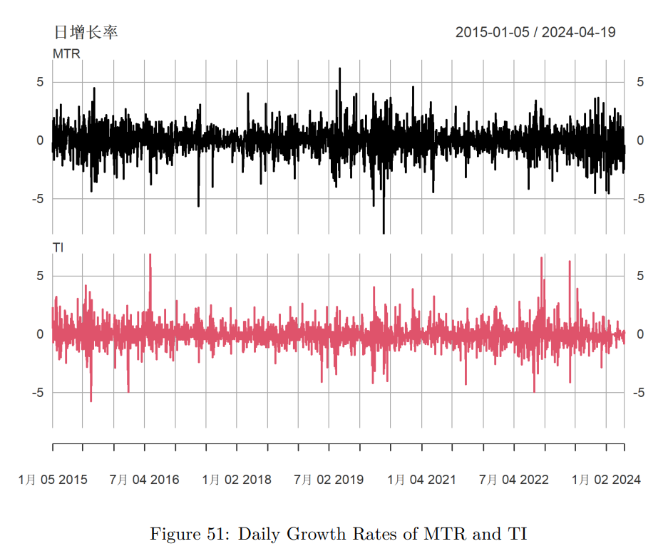
Multivariate Analysis
In this section, we use MTR and 载通 to construct a VARMA (Vector Autoregressive Moving Average) model. By considering the interdependencies and relationships between these two companies, we aim to gain deeper insights into the dynamics of the Hong Kong transportation industry.

Slide 25
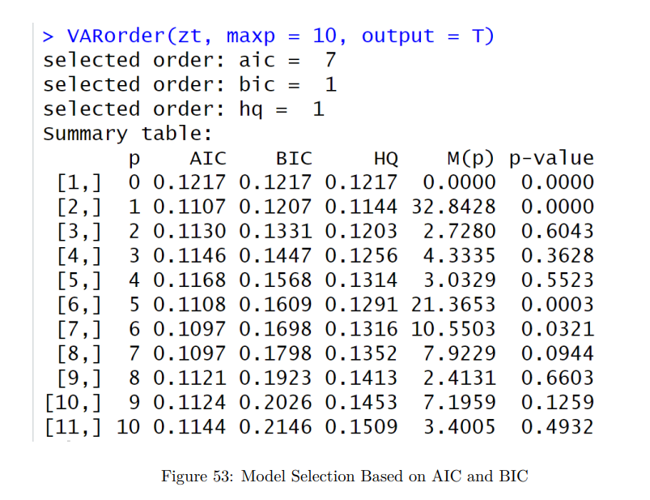
Model Selection
In this section, we employ the AIC (Akaike Information Criterion) standard to determine the optimal time series model for our analysis. By selecting the model with the lowest AIC value, we choose the VAR（7） as our optimal model.

Slide 26


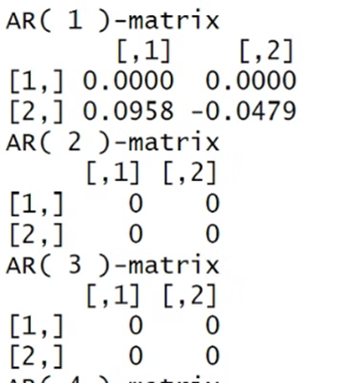
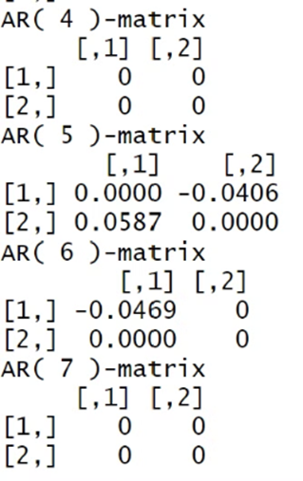
Model Estimation
In this section, we use the VAR model to estimate the parameters of our chosen time series model. By incorporating both autoregressive and moving average components with an asymmetric volatility model, we aim to capture the complex dynamics of the Hong Kong transportation stocks.

Slide 27
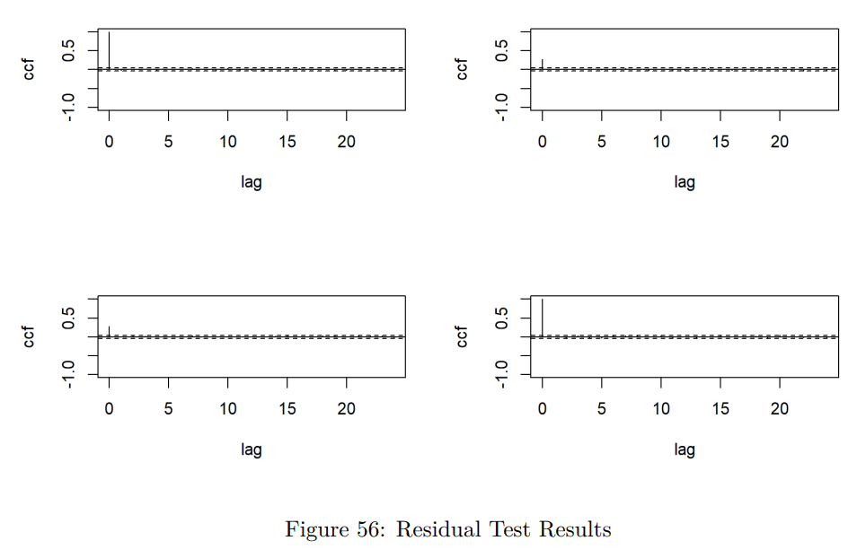
Model Checking
After estimating the parameters of our VAR(7) model, it's important to perform model checks to assess its validity. We'll examine residuals to see whether it is white noise using Ljung-Box test. It shows that the residuals are white-noise.

Slide 28

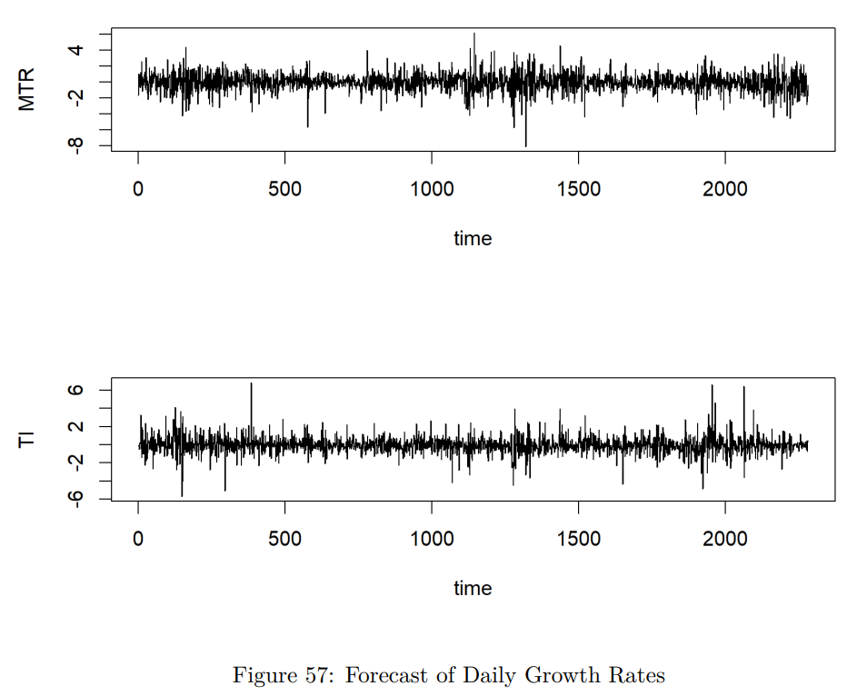
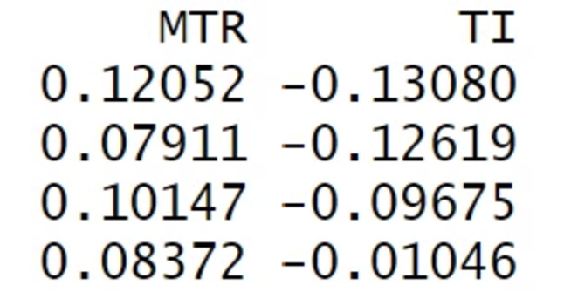
Forecasting
Now that we have successfully built and checked our VAR(7) model, it's time to use it for forecasting. We will utilize the estimated parameters and historical data to predict future values of the selected transportation stocks: MTR, and 载通. The forecasting result is as follows.

Slide 29
Conclusion and Discussion
06
·Summarizing key findings and insights from the analysis.
·Implications：Better risk management、Informed investment strategies、Improved operational planning

Slide 30
Conclusion Overview
Data Analysis
Modeling Approach
Advanced Modeling
Examined daily return data of KC, MTR, and TI.
Utilized ARMA(0,1)-EGARCH(1,1) models for KC, MTR, and TI.
Employed VARMA modeling on MTR and TI, selecting optimized VAR(7) model.

Slide 31

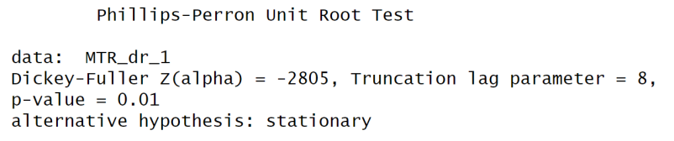
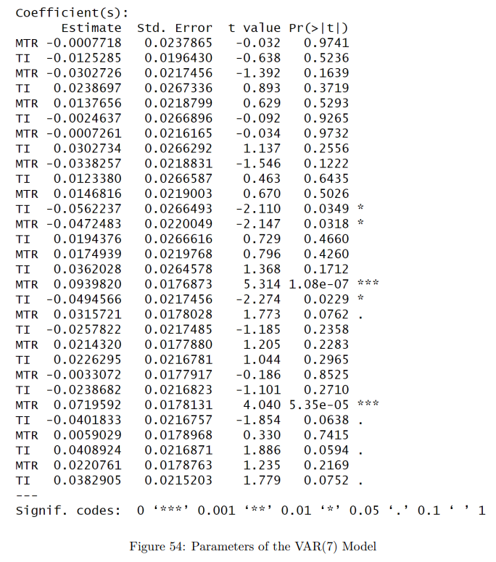
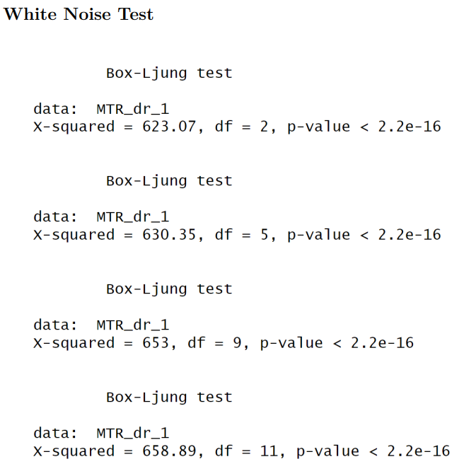
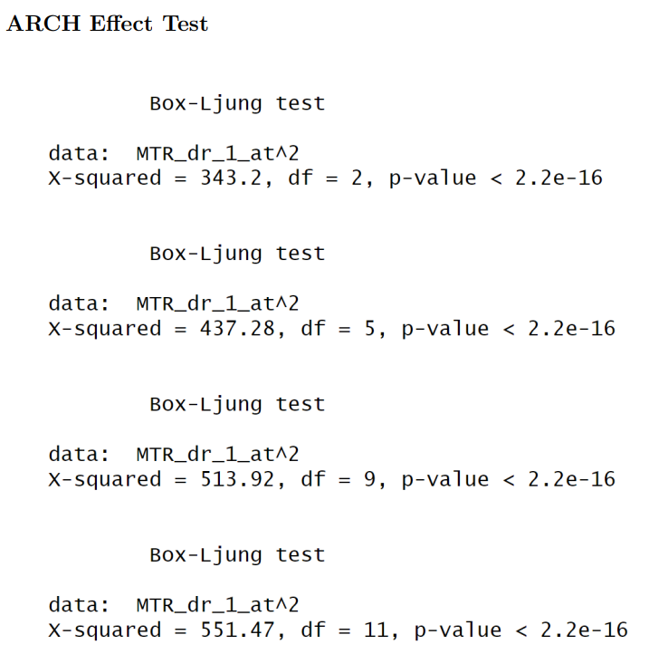
Conclusion: Model Evaluation
0 1
Passed Stationarity, White Noise, and ARCH Effect Tests.
VAR(7) model exhibited strong performance in both evaluation and prediction phases.
Statistical Tests
0 2
Performance:

Slide 32
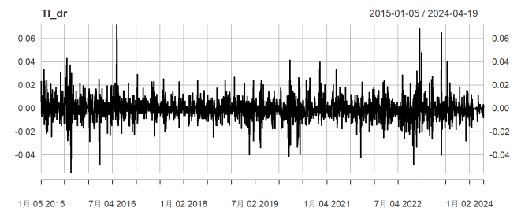
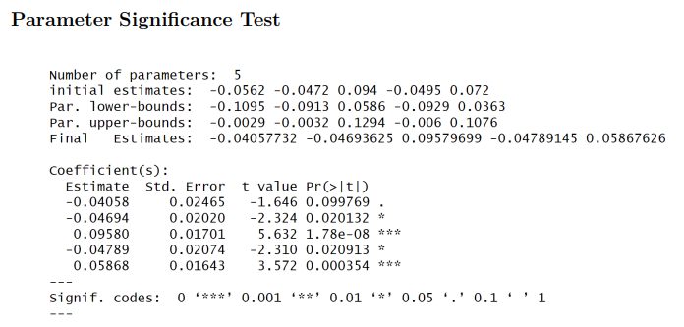
Conclusion: Data Considerations
Data Length Selection
Practical Implications
Chose data lengths ensuring passing of the white noise test: KC (4 years), MTR/TI (9 years).
Significance may differ with varied data lengths and real-world applications.

Slide 33

THANK YOU
Group 2
Please feel free to ask any questions you may have.

